Slide 1
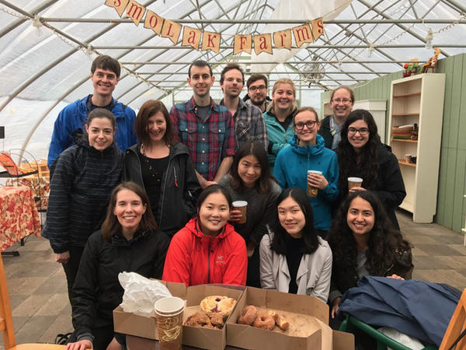
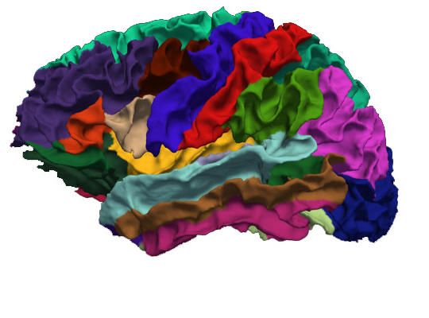
Proportional semantic pre-activation during sentence comprehension: Evidence from ERPs
Trevor Brothers, 2020

Slide 2
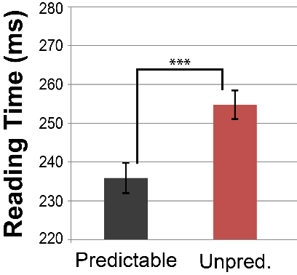
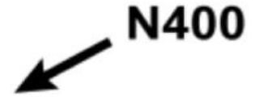
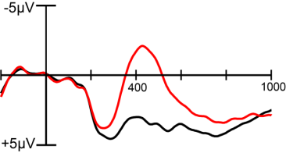
Anticipatory effects in sentence comprehension
Contextual predictability is one of the most important predictors of word-by-word processing difficulty in online sentence comprehension
A) For Halloween they were carving a large pumpkin
B) Before the party they bought a large pumpkin a
(Stanovich & West, 1979; Rayner & Well, 1996; Staub, 2015)
The magnitude of evoked neural responses (N400) is reduced to words that are more predictable (Kutas & Hillyard, 1984; Delong, Urbach & Kutas, 2005)

Slide 3
Alternative Explanations
A) For Halloween they were carving a large pumpkin
B) Before the party they bought a large pumpkin
Facilitation in predictive contexts is often interpreted as reflecting the pre-activation of linguistic information prior to its appearance in the bottom-up input
Readers combine semantic and syntactic constraints to predict upcoming content
Processing difficulty is reduced when the input “matches” prior predictions
But facilitation alone can’t provide direct evidence for anticipatory processing
Post-lexical integration difficulty
Prior Context
Semantic
Features
<orange>
<round>
Input
PUMPKIN

Slide 4
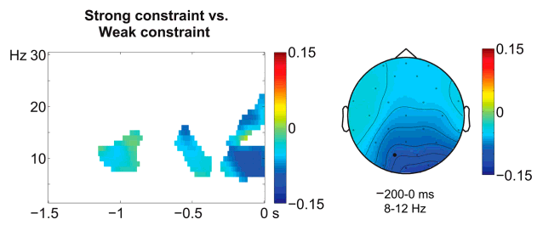
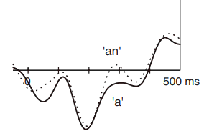
Evidence of prediction before word onset?
Some studies have demonstrated differences in neural activity before the onset of an anticipated word
Pre-stimulus constraint effects – Are there differential neural responses in strongly vs. weakly constraining sentence contexts?
But, alternative explanations exist (e.g. attention)
Prediction mismatch paradigm – Are readers sensitive to the mismatch between the current input and an upcoming anticipated word?
Phonological mismatch - Delong (2005)
Syntactic Gender Mismatch - Van Berkum et al. (2005)
Strong: The children went outside to…
Weak: Joyce was too frightened to…
Rommers et al., 2016
Wang, Hagoort & Jensen, 2017
The day was breezy so the boy went outside to fly a/an …
kite

Slide 5
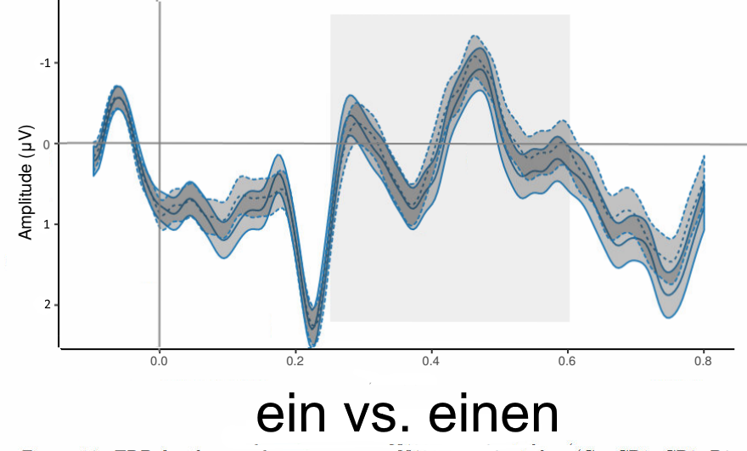
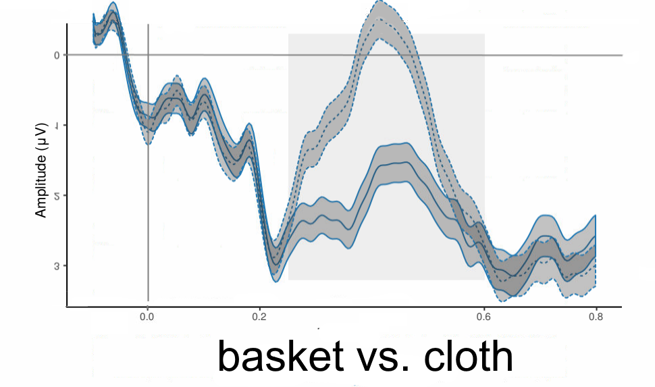
Large-scale replication failures
Large scale replication studies have called into question the robustness of pre-target prediction effects - Nieuwland, et al., 2019
Pre-target effects are sometimes seen at slower than normal presentation rates (500-700ms per word), but there is little direct evidence for pre-activation at more typical reading speeds - Wlokto & Federmeier (2015) - Delong (2009)
Niecenboim, Vasishth & Rösler (2019)
Translated from German:
The grandmother wants to pick mushrooms in the forest.
She takes a(masc/fem) large basket/cloth…
N = 121

Slide 6
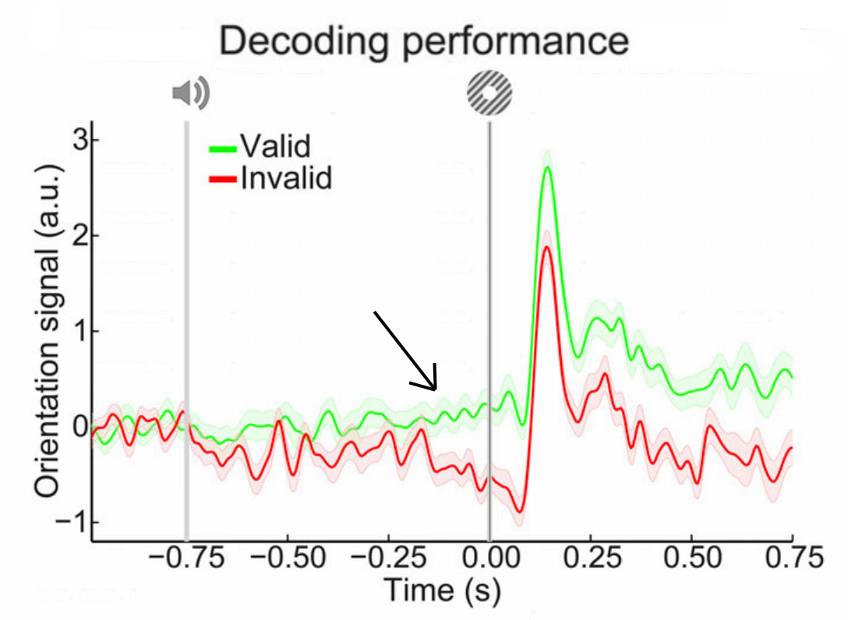
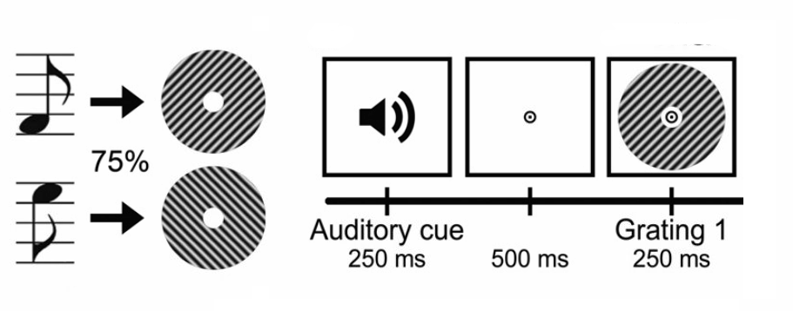
Three criteria for establishing direct evidence of predictive processing
Neural responses should be observable before the onset of the expected input
These responses should be “representational” in nature, tracking relevant features of the upcoming stimulus
The magnitude of these effects should scale proportionally with the probability of the upcoming target
Kok, Mostert, de Lange, 2017

Slide 7
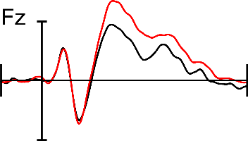
Using “concreteness” to probe semantic activation
To probe whether readers are actively anticipating semantic information we investigated the semantic “concreteness” effect
Words with more concrete meanings elicit larger N400 responses compared to abstract words
both in isolation (Swaab, Baynes & Knight, 2002)
and in sentence contexts (Holcomb, et al., 1999)
Dual coding account - Abstract words activate verbal codes, while concrete words activate both verbal and perceptual semantic information
Concrete
pumpkin
book
couch
gravy
Abstract
ideas
truth
memory
wish

Slide 8
Primary Questions
Are concreteness effects always triggered bottom-up by the word itself? or…
In constraining contexts, will we see evidence of semantic pre-activation (abstract vs. concrete) prior to word onset?
If we do observe semantic pre-activation, how will it affect semantic retrieval after word onset?
Will these effects be graded as a function of contextual predictability (low, medium, high)?
…pumpkin…
For Halloween they were carving the large…
Concreteness Effect
?
Low
Med
High
Predictability

Slide 9
Experimental Materials
216 sentence triplets (91%, 20%, 1% cloze)
Word probabilities obtained from Mturk
90 responses x 648 contexts = +58,000 completions
Concreteness ratings (1-5) from Brysbaert, et al., (2014)
cloze probability
Concrete
HC: For Halloween, they were carving a large pumpkin at the farmer’s market. (97%)
MC: For the pie, they bought a large pumpkin at the farmer’s market. (12%)
LC: Before the party, they bought a large pumpkin at the farmer’s market. (1%)
Abstract
HC: After hours of brainstorming, they had run out of ideas to solve the problem. (90%)
MC: The consultant said that he had run out of ideas to solve the problem. (15%)
LC: The chef said that he had run out of ideas to solve the problem. (1%)

Slide 10
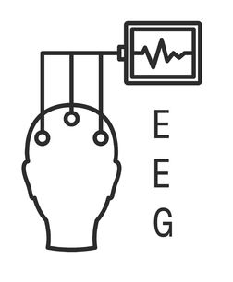
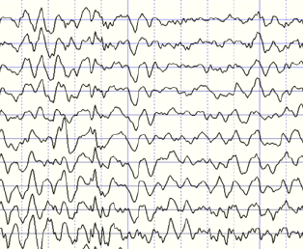
Experimental Methods
32 participants
Tufts undergrads
T/F comp. questions
Self-paced (~250ms)
N400 (300-500ms)
Participants read 216 critical sentences for comprehension, using a self-paced visual presentation
Ditman, Holcomb & Kuperberg (2007); Tanner (2018)
Participants answered comprehension questions (25% of trials)
EEG was baseline corrected (-600 to -200ms) before critical word onset
ERP amplitudes analyzed using maximal LMERs with continuous predictors (cloze x concreteness)
“anticipatory” window (-200 to 0ms)
N400 window (300-500ms)
a
large
pumpkin

Slide 11
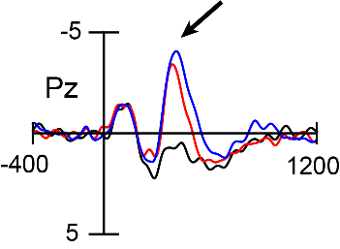
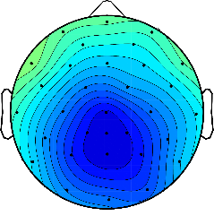
Main effects of Predictability
N400
Reading times at the critical word were similar across conditions
(HC: 276ms, MC: 278ms, LC: 278ms, t < 1)
Over posterior sites, there was a graded reduction in N400 amplitudes as predictability increased
b = 2.89, t = 9.76, p <.0001

Slide 12
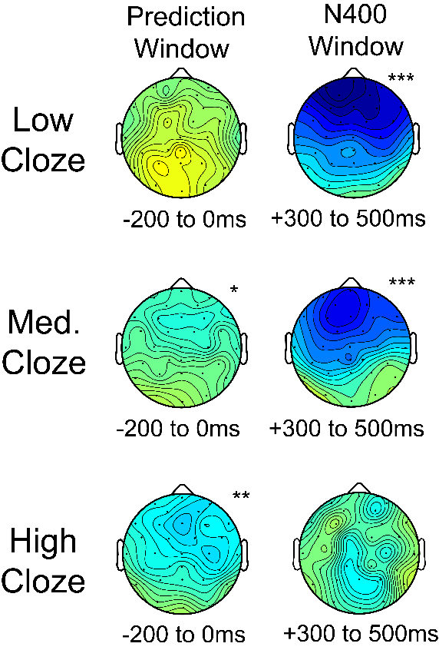
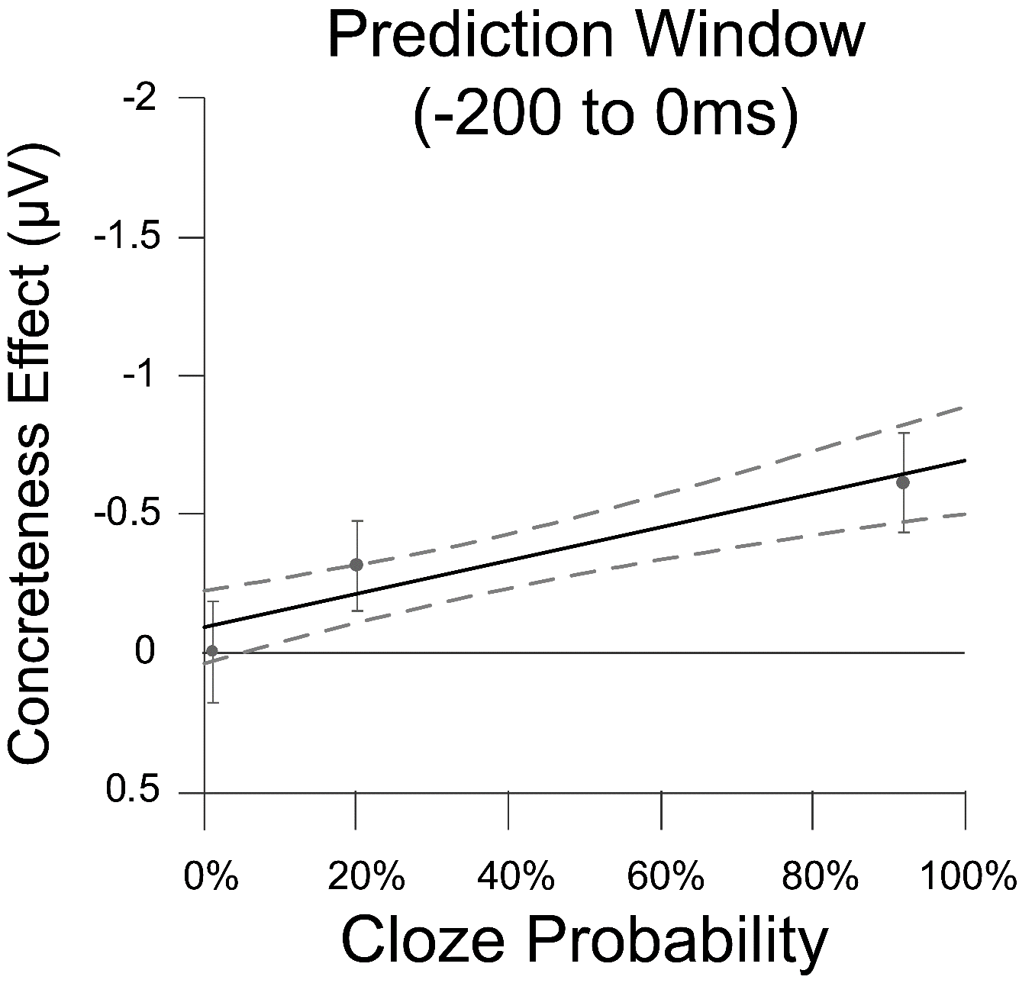
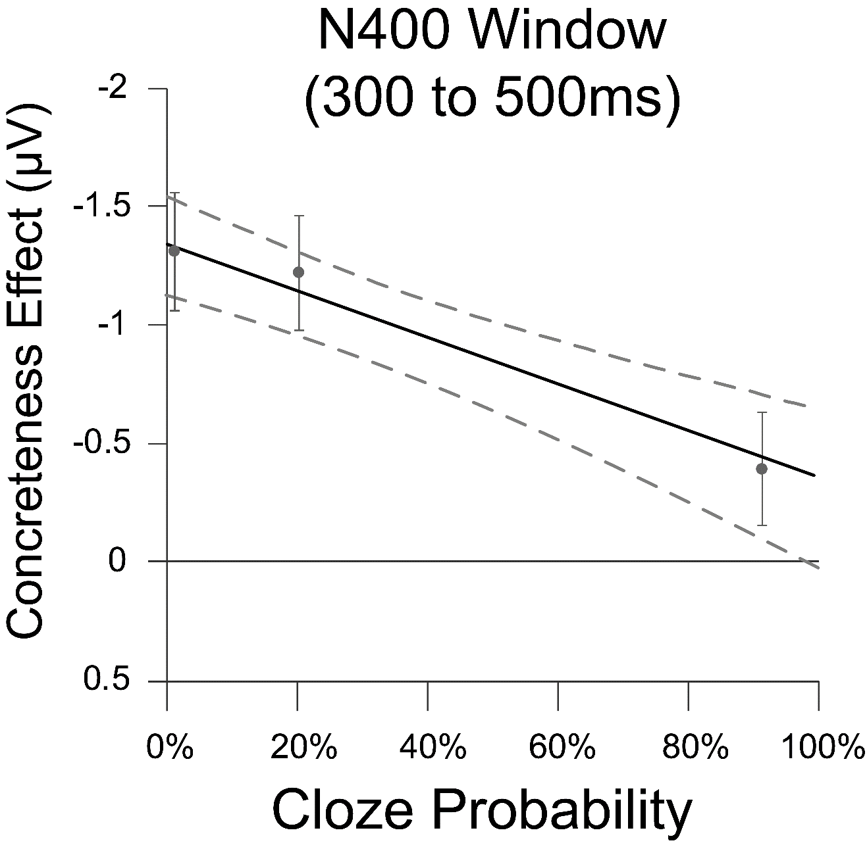
Concrete words
a large pumpkin
Abstract words
Low (1%): Before the party they bought a large pumpkin…
Med (20%): : For the pie, they bought a large pumpkin…
High (91%): For Halloween, they were carving a large pumpkin…

Slide 13
Direct Evidence for Proportional Pre-activation
cloze x concreteness
t = -2.40, p = .017
cloze x concreteness
t = 2.73, p = .006
Semantic pre-activation (top-down) and semantic retrieval (bottom-up) showed a trade-off relationship
With stronger contextual constraints:
Semantic pre-activation increased
Semantic retrieval triggered by the critical word decreased
This is consistent with proportional pre-activation accounts: readers predict and facilitation occurs whenever top-down predictions are confirmed by the bottom-up input
These effects were graded, with significant pre-activation occurring even in moderately constraining contexts (20% cloze)

Slide 14
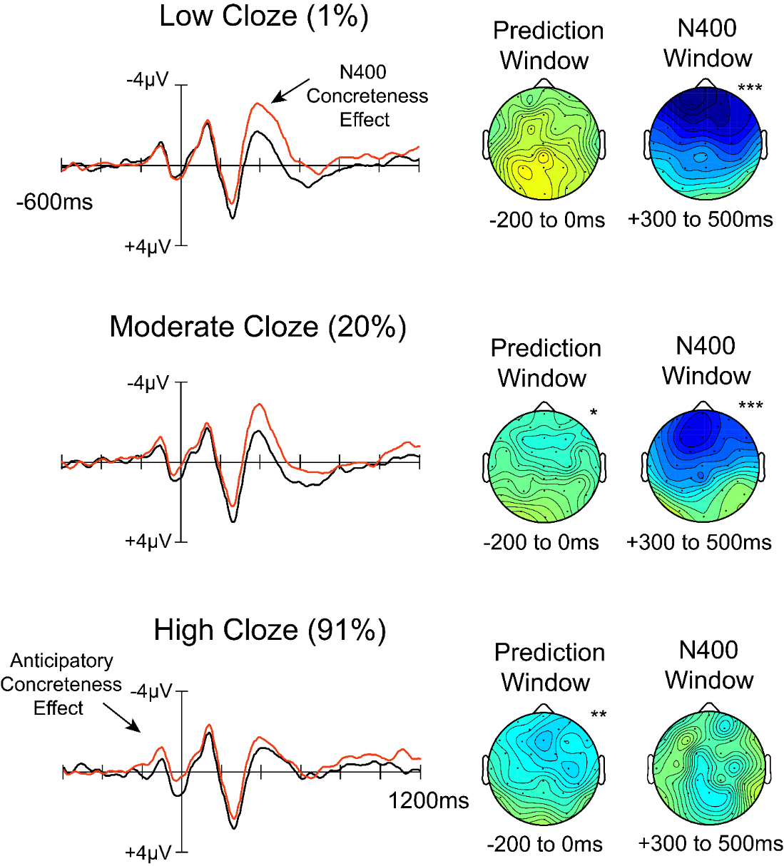
Direct Evidence for Proportional Pre-activation
These results provide direct evidence of semantic pre-activation during online reading comprehension, which cannot be attributed to:
Differences in integration difficulty
Pre-stimulus lexical confounds
Slow word-by-word presentation rates
Artificial task demands

Slide 15
THANK YOU!
Thanks to NSF and everyone in the Neurocognition of Language Lab for their support!
Special thanks to: Santiago Noriega, Emma Fleischer and Sophie Greene!

Slide 16
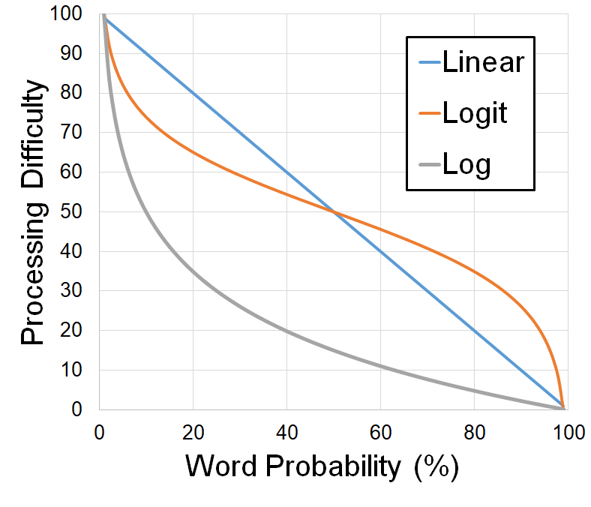
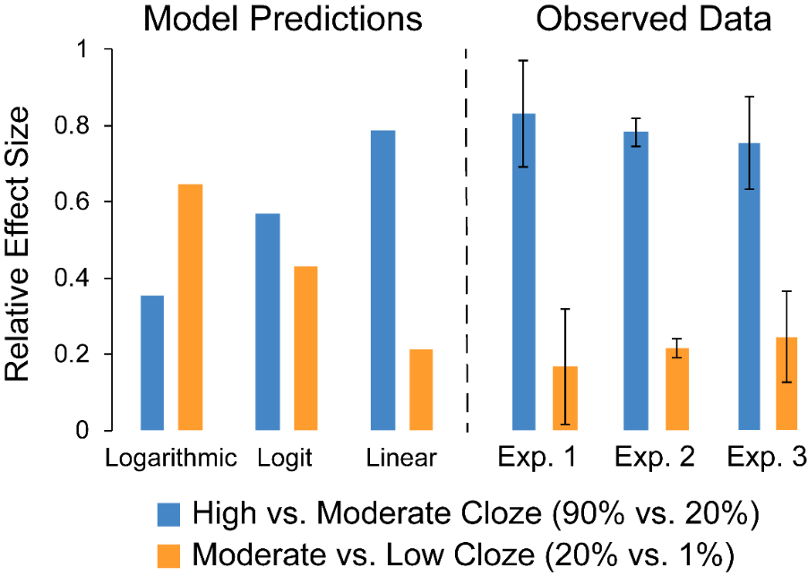
Are Predictability Effects Linear or Logarithmic?
Compared to a logarithmic model, linear models showed a consistently higher Log Likelihoods across participants, t(31) = 2.21, p = .03

